Slide 1

HEART DISEASE DETECTION USING MACHINE LEARNING
BATCH MEMBERS:
Arunkumar R [513319104006]
Nithish Kumar B [513319104022]
Panneerselvam K [513319104025]
Surya A [513319104041]
GUIDE:
Mrs.G.Julin Leeya, M.Tech.,
CSE Department
UCEA

Slide 2
ABSTRACT
Heart disease is a term that assigns large number of medical conditions related to heart.
The key to Heart (Cardiovascular) diseases to evaluate data compare information that can be used to predict , prevent and manage such as heart disease.
Heart disease is because of stress , blood pressure , cholesterol, diabetes, smoking etc.,
We implement new Machine Learning algorithms which gives better performance .
And we use group by to cluster the people with similar health condition.

Slide 3
INTRODUCTION
It is commonly believed that heart disease, which is brought on by abnormalities in the heart and blood vessels, directly endangers human life and health.
It is one of the serious illnesses that affects many older and middle-aged persons in an irreversible manner and that frequently leads to deadly consequences.
Scientists asserts that cardiovascular heart disease increases the risk of death and disability in those 65 and older.

Slide 4
LITERATURE SURVEY
AUTHOR | TITLE | YEAR | ADVANTAGE | DISADVANTAGE
Madhu H.K. | Heart Attack Analysis and Prediction using SVM | 2021 | In this paper SVM a supervised model is implemented to predict heart attack. Smart gadgets from tiny oximeter to wrist watches collect data from human body to analyse and predict future occurrences. | Expected accuracy has not been met. Algorithm has high computational complexity makes it more suitable compared to other techniques.
Mert Ozcan | A classification and regression tree algorithm for heart disease modeling and prediction | 2022 | The classification-based machine learning to medicine facilitates earlier detection The importance of features in the decision tree analysis has been investigated | They does not totally include patients’ medical information The proposed algorithm can support not only healthcare professionals

Slide 5
LITERATURE SURVEY
AUTHOR | TITLE | YEAR | ADVANTAGE | DISADVANTAGE
Apurb Rajdhan | Heart Disease Prediction using Machine Learning | 2020 | It implementing different ML Algorithm such as Naive Bayes, Decision Tree Effectively predict if the patient suffers from heart disease | The system is not fully automated, it needs data from user for full diagnosis. Data mining is hard and complex
Galla Siva Sai Bindhika | Heart Disease Prediction Using Machine Learning Techniques | 2020 | Handles roughest(enormous) amount of data using random forest algorithm and feature selection. Reduce the time complexity of doctors | Cannot handle enormous datasets for patient records. Prediction of cardiovascular disease results is not accurate.

Slide 6
EXISTING SYSTEM
We came to know that machine learning algorithms with self-measurable indicators do not predict more accurately as ML algorithms with all Medical condition indicators .
Self-measurable indicators are also more likely to false negative predict for people who don’t have that heart disease.
Thus, ML algorithms with only self-measurable indicators shouldn’t be used until some other indicators are measurable at home in future.

Slide 7
PROPOSED SYSTEM
We include 14 health attributes from the original dataset.
We Found the machine learning algorithm that has the best accuracy and the lowest false negatives.
We create a Machine Learning Model with different test size and random state to get better performance.
Since each patient has a unique set of medical conditions, so we group the patients those who have similar conditions like clusters.

Slide 8
ADA BOOST
Parent node
Child node 1
Child node 2
The AdaBoost combines with two more algorithms of Decision Tree and Random Forest for greater performance.
This gives the rule of child node follow the parent node and with the condition of one parent node with two child nodes.

Slide 9
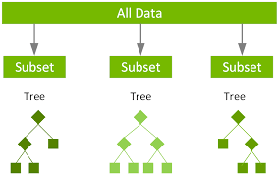
XGB
It is a scalable, distributed gradient boosted decision tree (GBDT) machine learning library.
It provides parallel tree boosting and is the leading machine learning library for classification

Slide 10
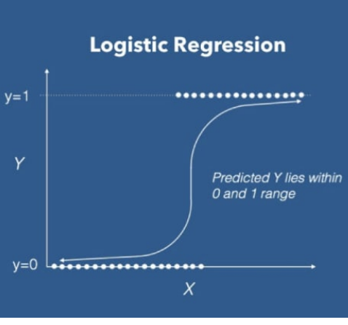
Logistic Regression
Logistic Regression is used to model the probability of a certain class or event
It is usually used for Binary classification problems.

Slide 11
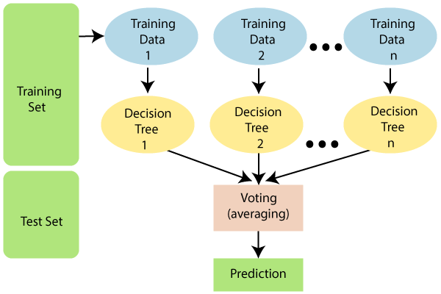
Random Forest
It contains a number of decision trees on various subsets of the given dataset
It takes the average to improve the predictive accuracy of that dataset

Slide 12
Architecture Design
User
Data requirements for prediction of heart disease
Pre-processing
Create model using different machine learning algorithms
Heart disease predictor’s result
Calculating result

Slide 13
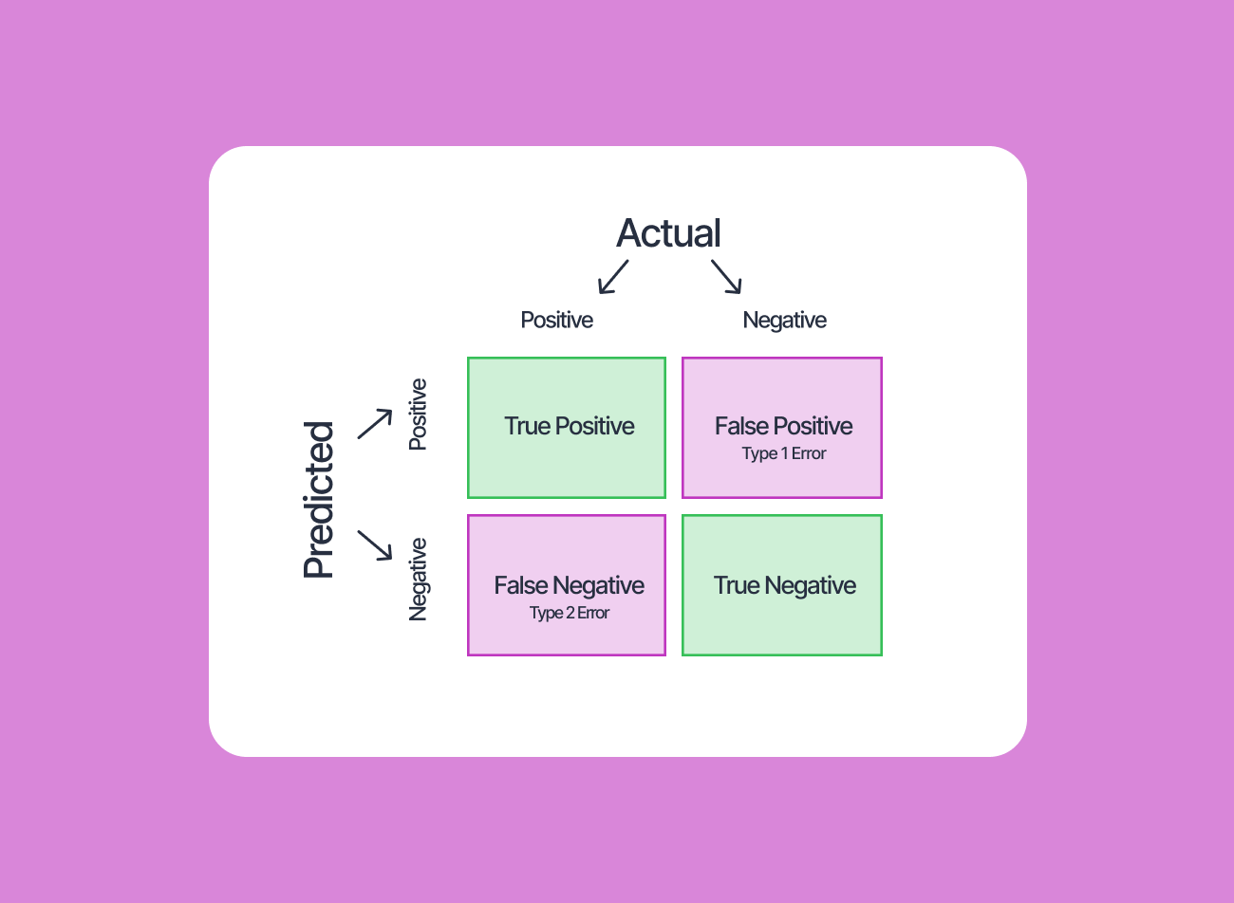
Confusion matrix
A confusion matrix is a performance measurement technique for a machine learning classification algorithm

Slide 14




Confusion Matrix
1)Logistic Regression
2)Ada
3)Xgb
4)Random forest

Slide 15




Results
1)Logistic Regression
2)Ada
3)Xgb
4)Random forest

Slide 16
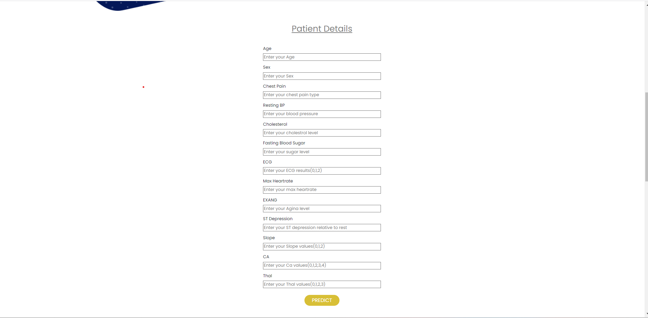
Expected Outcome
Patient Details

Slide 17
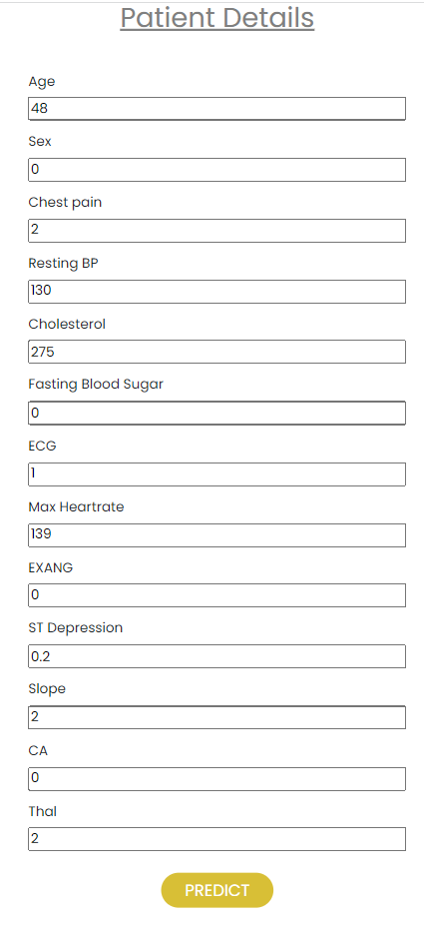

Expected Outcome
Heart disease occuring

Slide 18
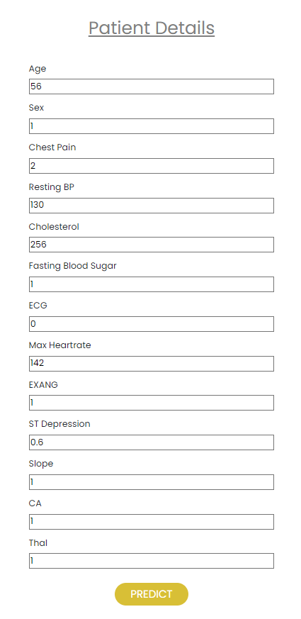
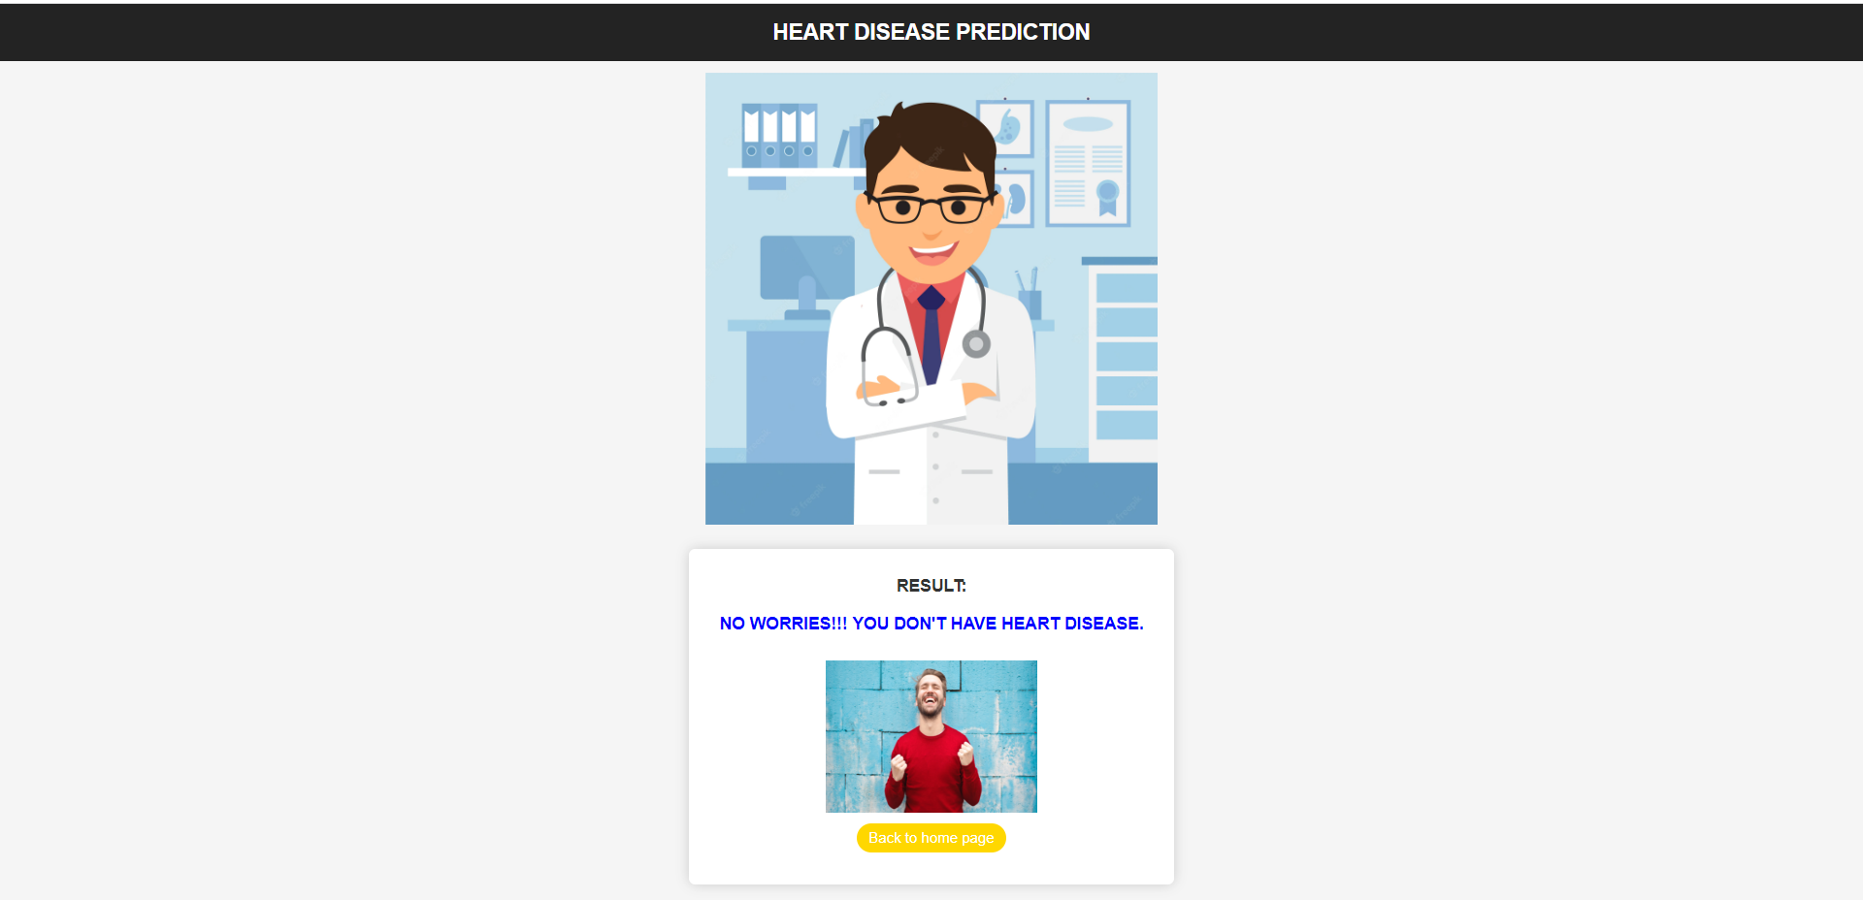
Expected Outcome
Heart disease not occurring

Slide 19
References
Madhu H.K, Heart Disease Prediction Using Effective Machine Learning Techniques, International Journal of Recent Technology and Engineering, Vol 8, pp.944-950,2019.
Galla Siva Sai Bindhika, Heart Disease Prediction using Data Mining with Mapreduce Algorithm, International Journal of Innovative Technology and Exploring Engineering (IJITEE) ISSN: 2278-3075, Volume-8 Issue-3, January 2019.
Fahd Saleh Alotaibi, Implementation of Machine Learning Model to Predict Heart Failure Disease, (IJACSA) International Journal of Advanced Computer Science and Applications, Vol. 10, No. 6, 2019.
Apurb Rajdhan,Heart disease prediction using machine learning, International Conference on Trends in Electronics and Information(ICOEI 2019).
Galla Siva Sai Bindhika,Human heart Disease Prediction System Machine Learning Techniques, International Conference on Circuit Power and Computing Technologies,Bangalore,2016.
Akkaya, B., Sener, E. and Gursu, C. (2022) A Comparative Study of Heart Disease Prediction Using Machine Learning Techniques. 2022 International Congress on Human-Computer Interaction, Optimization and Robotic Applications (HORA), Ankara,9-11 June 2022.https://doi.org/10.1109/HORA55278.2022.9799978
Xing, Y.W., Wang, J., Zhao, Z.H. and Gao, Y.H. (2007) Combination Data Mining Methods with New Medical Data to Predicting Outcome of Coronary Heart Disease.Convergence Information Technology, Gwangju, 21-23 November 2007, 868-872.https://doi.org/10.1109/ICCIT.2007.204
Nahar, J., Imam, T., Tickle, K.S. and Chen, Y.P.P. (2013) Computational Intelligence for Heart Disease Diagnosis: A Medical Knowledge Driven Approach. Expert Systems with Applications , 40, 96-104.https://doi.org/10.1016/j.eswa.2012.07.032
Desai, F., Chowdhury, D., Kaur, R., Peeters, M., Arya, R.C., Wander, G.S., Gill, S.S. and Buyya, R. (2022) HealthCloud: A System for Monitoring Health Status of Heart Patients Using Machine Learning and Cloud Computing. Internet of Things , 17, Article Id : 100485.https://doi.org/10.1016/j.iot.2021.100485
Nahar, J., Imam, T., Tickle, K.S. and Chen, Y.-P.P. (2013) Association Rule Mining to Detect Factors Which Contribute to Heart Disease in Males and Females. Expert Systems with Applications , 40, 1086-1093. https://doi.org/10.1016/j.eswa.2012.08.028
Wilson, P.W.F., D’Agostino, R.B., Levy, D., Belanger, A.M., Silbershatz, H. and Kannel, W.B. (1998) Prediction of Coronary Heart Disease Using Risk Factor Categories.Circulation, 97, 1837-1847.https://doi.org/10.1161/01.CIR.97.18.1837
Liu, X., Wang, X.L., Su, Q., Zhang, M., Zhu, Y.H., Wang, Q.G. and Wang, Q. (2017) A Hybrid Classification System for Heart Disease Diagnosis Based on the RFRS Method. Computational and Mathematical Methods in Medicine , 2017, 1-11.https://doi.org/10.1155/2017/8272091
Makino, K., Lee, S., Bae, S., Chiba, I., Harada, K., Katayama, O., Shinkai,Y. and Shimada, H. (2021) Absolute Cardiovascular Disease Risk Assessed in Old Age Predicts Disability and Mortality: A Retrospective Cohort Study of Community-Dwelling Older Adults. Journal of the American Heart Association, 10, e022004.https://doi.org/10.1161/JAHA.121.022004
Nagaraj M Lutimath,Chethan C,Basavaraj S Pol.,Prediction Of Heart Disease using Machine Learning, International journal Of Recent Technology and Engineering,8,(2S10), pp 474-477, 2019.DOI:10.35940/ijrte.B1081.0982S1019
Fahd Saleh Alotaibi, Implementation of Machine Learning Model to Predict Heart Failure Disease, (IJACSA) International Journal of Advanced Computer Science and Applications, Vol. 10, No. 6, 2019.Digital Object Identifier (DOI) : 10.14569/IJACSA.2019.0100637

Slide 20
THANK YOU

